Slide 1
First Project Demo & Presentation
P56: Benchmark Commercial AI product for Medical Imaging Services Provider

Slide 2
Overview Of the Project Goals, Stakeholders and Scope
Project Goal
The project’s aim is to identify the best computer-aided detection (CAD) commercial products that will be able to diagnose TB that is on the market for our clients to use with high confidence and research to support the decision with a focus on performance and validation and usability and integration.
Stakeholders
Medical health care professionals who do the screenings for TB
Regulators, Program directors
Board of health service companies
Users of the technology who are screened
Scope
Diagnostic test accuracy of qXR benchmarked against its competitors through a systematic review and meta-analysis.
Systematic review and meta-analysis to identify factors affecting user acceptance and the impact of implementing the technology on the clinical workflow of radiologists.

Slide 3
System Specification
Functional:
Prove that AI is technically viable
Benchmark qXR against other AI products
Identify AI accuracy
Identify AI efficiency
Non-Functional:
Report covers all requirements
Meets client’s time demands
Report uses reliable research
Technical Constraints:
Availability of research papers
Validity of research papers
Usability of dashboard
As a radiologist, I want to ensure that qXR is the most appropriate AI tool for my needs so that I can treat my patients accordingly.
Acceptance Criteria: qXR successfully benchmarked against competitive AI tools that are certified

Slide 4
Quality Of Work
Testing Plan
Article Quality
Systematic Review Quality
Meta-Analysis Quality
Evaluation Quality
Report Quality
Presentation Quality
Limitations
Use of subjective tests

Slide 5
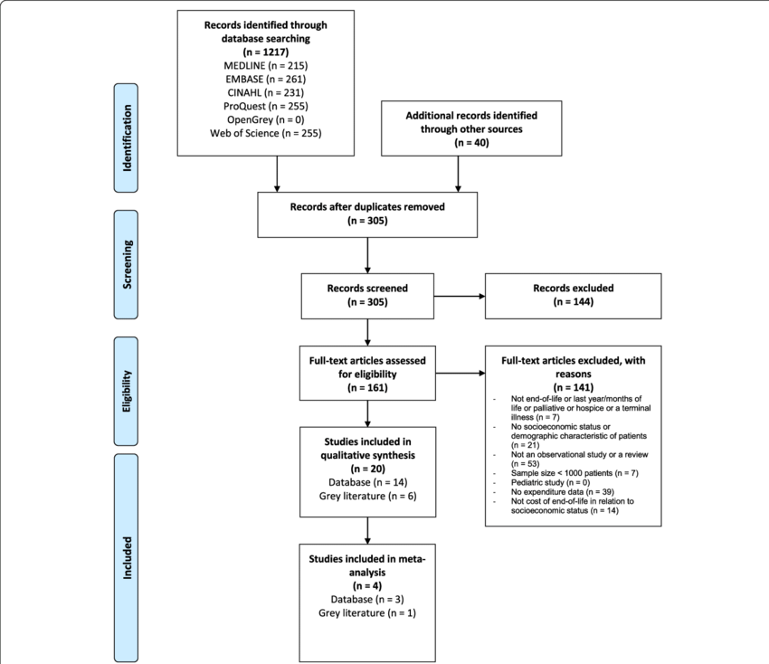
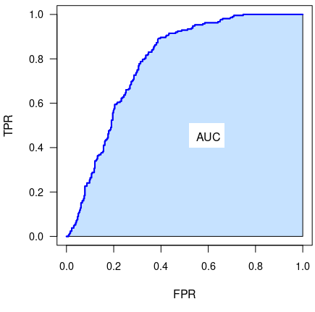
Discipline
Two major terms to be explained: “AUC” and “Prisma”
Notes:
In this project, we used a lot of data analysis and statistics knowledge. Here I will introduce the two most important terms, "AUC" and "PRISMA".
AUC is the projection of the ROC curve to the x-axis. The two values that constitute ROC are true positive and false positive ratios, so the area of AUC is positively correlated with AI performance.
PRISMA is an evidence-based minimum set of items for reporting in systematic reviews and meta-analyses. In this project, we also used prisma. Using prisma, we can focus more on the problem we want to explore. With the drop of low-relevance articles again and again, the conclusion we draw from mate-analysis will be more Approaching our problem.

Slide 6
Plan for Remaining Requirements/User Stories Potential Project Risks
Finalize the systematic review for our TB products
Work through the user stories left
Start to prepare meta analysis for the project
Prepare the client deployment and doing a demo for our client
Project Risks:
Not enough articles
Lack of data

Slide 7
Group Processes Including Collaboration and Roles, Client Interaction and Potential Improvements

Slide 8
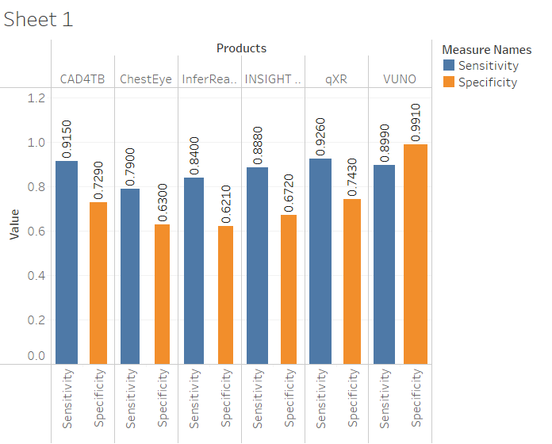
Demonstration

